Slide 1
Automatic robotic wheelchair
Project by :sai reddy 17261A0551
Vardhan 17261A04E8
Phani 17261A04G8

Slide 2
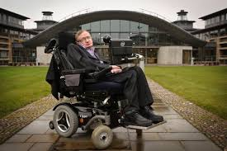
Stephen Hawking amyotrophic lateral sclerosis
At the age of 21, Stephen Hawking was diagnosed with amyotrophic lateral sclerosis.
From then he is moving using a wheel chair.

Slide 3
What is this project ?
Its a automated robot wheel chair which is related to IOT(this is just a model of wheel chair ), this wheelchair is voice controlled ,this robot can also check the obstacles and avoid it by nodding its head (its a sigh that it wont be able to move to the spoken direction) , this wheel chair when flipped it sends a sms that the chair is flipped to the Concerned person and also sends a the location of it and also make a call that the wheel chair is flipped and makes a huge siren of sound when flipped.

Slide 4
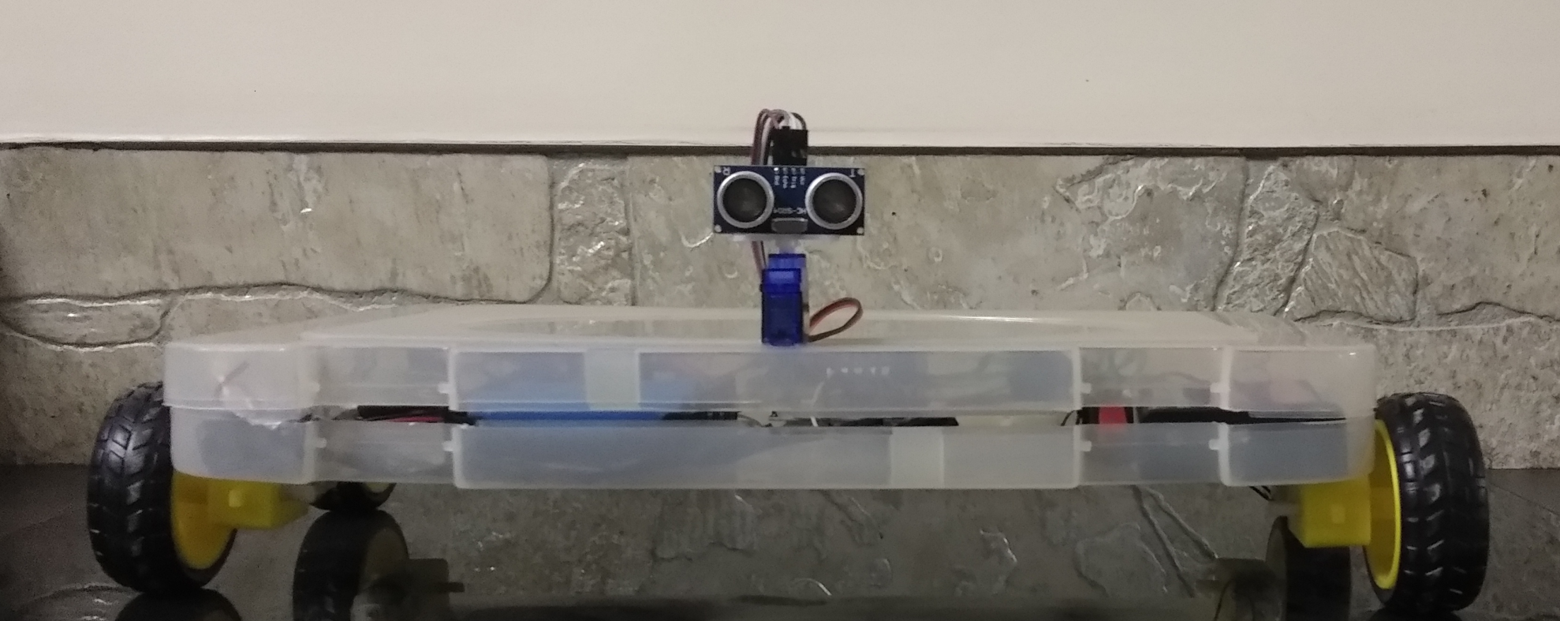
Automated wheelchair model

Slide 5
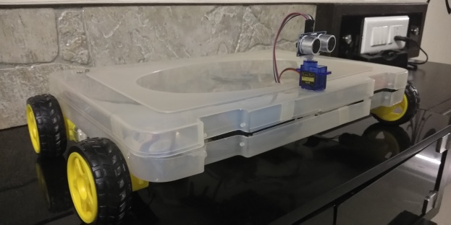
Why is this project ?
This project is for the people who should have a assistance to move. This project makes easy to move using voice , this reduces the dependence of the victims on others
It just costs a penny (cost efficient)
Easily can locate the person and make call with messaging the person accurate location

Slide 6
Advantages of this wheelchair
Works with voice control
For dump we can alternate with gesture control
Easy location of the person in wheelchair
Immediately notifications using various means if flipped

Slide 7
Thank you

